Slide 1

Overview of the Semester

Slide 2
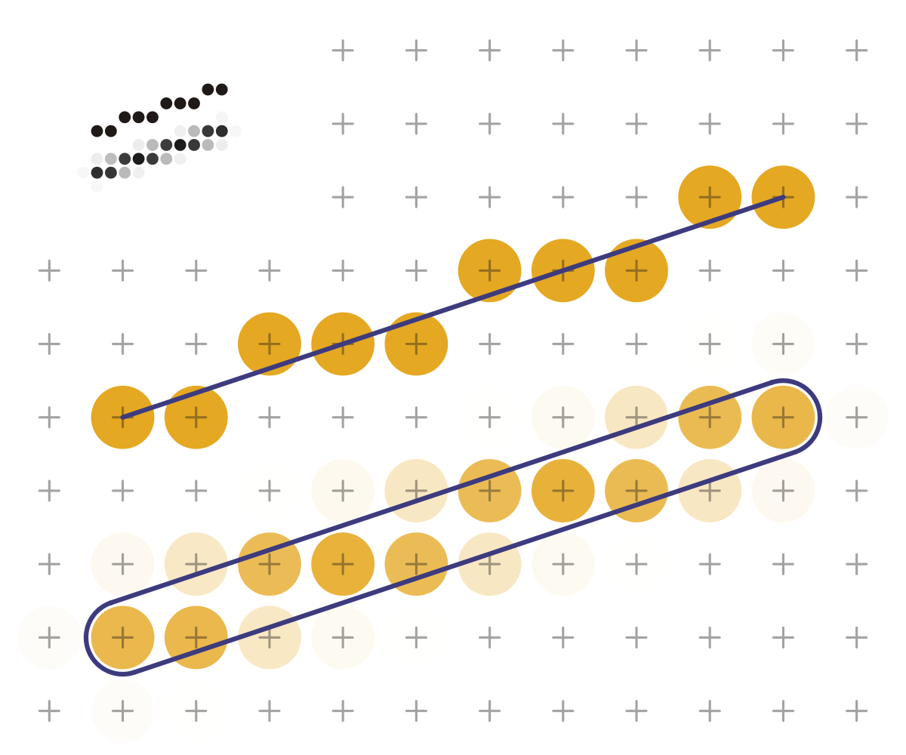
Scan-line conversion algorithms
Line Drawing Algorithms
DDA
Midpoint
Midpoint with eight way symmetry
Circle Drawing Algorithm
Midpoint
Polygon Filling Algorithm

Slide 3
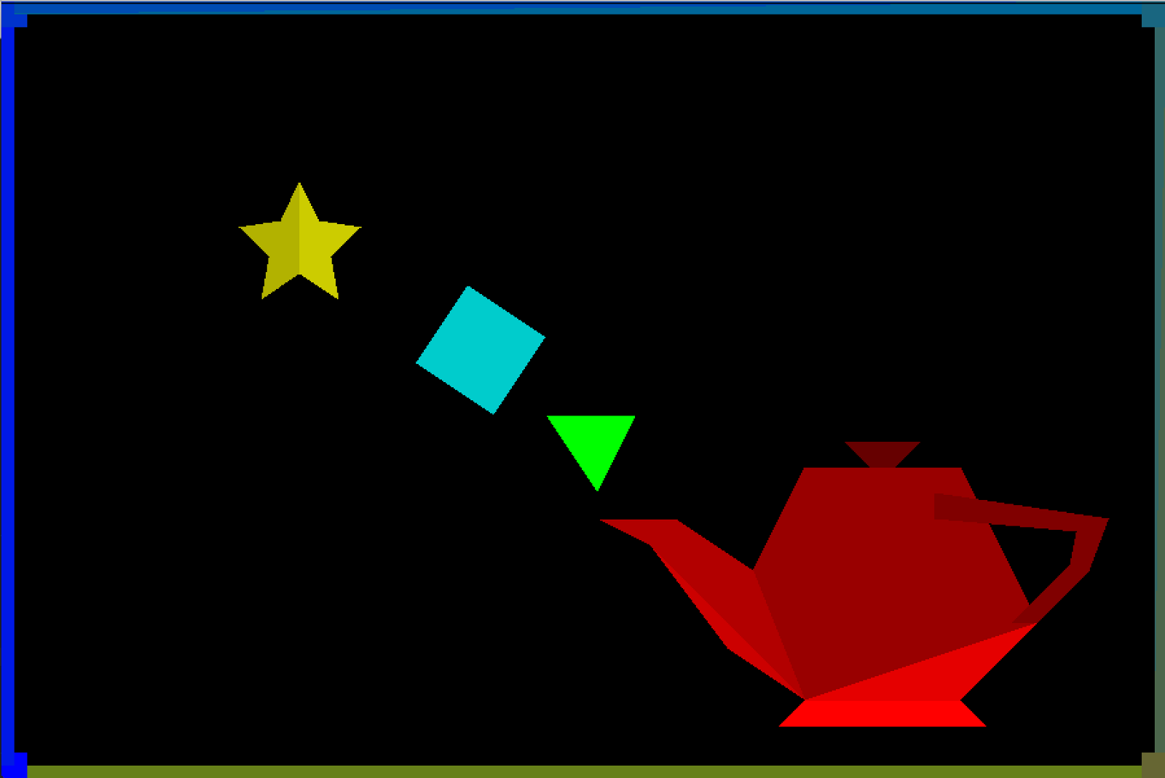
Scan-line polygon filling algorithm

Slide 4
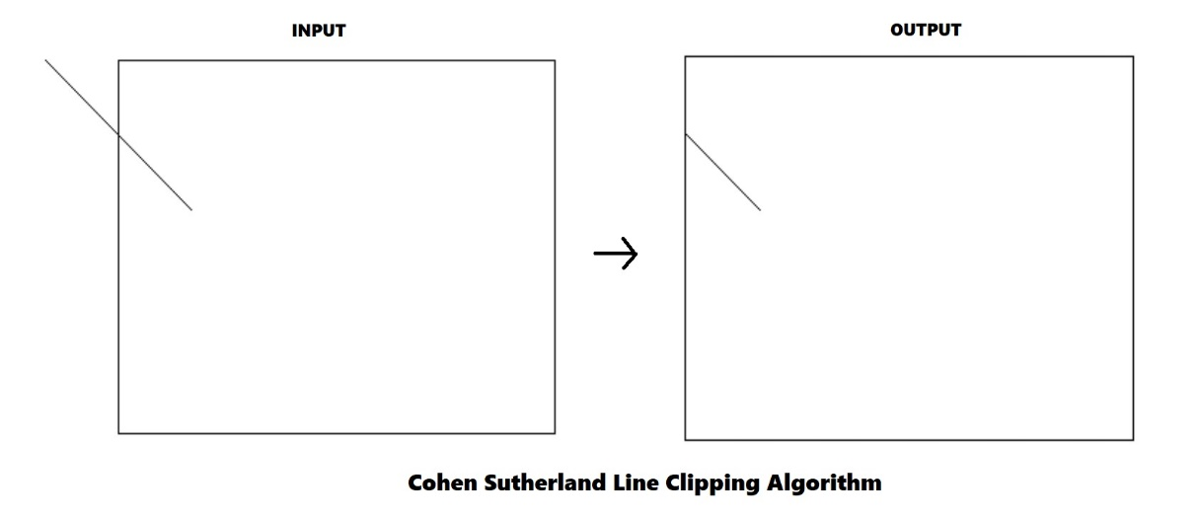
Clipping algorithms
Line clipping algorithms
Cohen-Sutherland
Cyrus-Beck
Polygon clipping algorithm
Sutherland-Hodgman

Slide 5
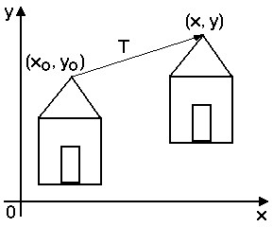
Transformation
Translation

Slide 6
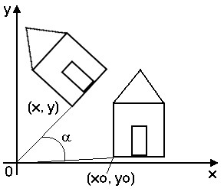
Transformation
Rotation

Slide 7
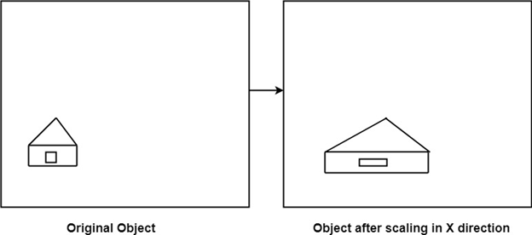
Transformation
Scaling

Slide 8
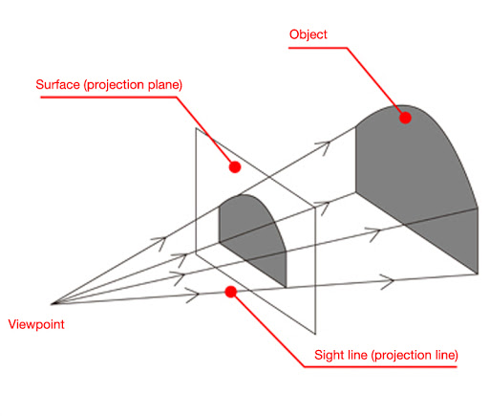
Projection
Perspective projection

Slide 9
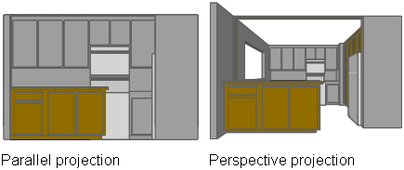
Projection
Parallel projection

Slide 10
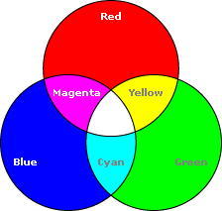
Color models
RGB
HSV
HSL

Slide 11
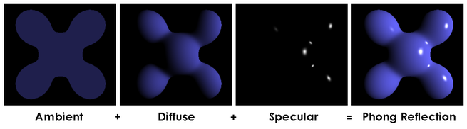
Illumination models
Global illumination
Diffuse reflection

Slide 12
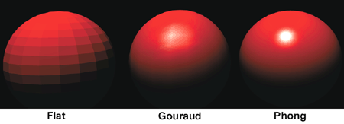
Shading

Slide 13
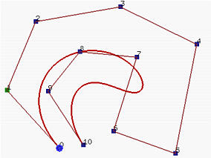
Curves & Splines

